Slide 1
Time Complexity
Dr. Naveen Kumar
Associate Professor
Amity Institute of Information Technology
Amity University Patna

Slide 2
Algorithm vs Program
Algorithm | Program
Written at Design Time | Implementation Time
Domain Knowledge | Programmer
Any Language | Programming Language
HW/OS independent | HW/OS dependent

Slide 3
Analyze Algorithm
Time
Space
Network Consumption
Power Consumption
CPU Register or Device Drivers

Slide 4
Example
Algorithm swap(a, b){
Temp = a
a = b
B = temp
}
Each step takes single time unit
f(n) = 3 = constant value
Constant denoted as O(1)
S(n) = 3, Again constant space value

Slide 5
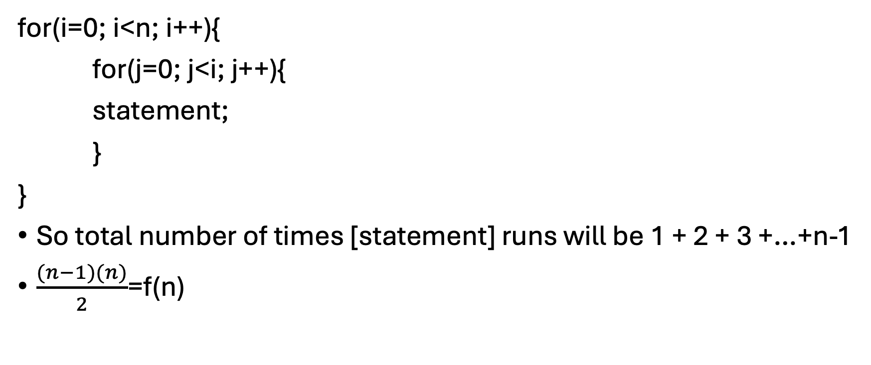
Example
No. of time I runs | No of times j runs | No of times Statement runs
0 | 0 | 0
1 | 0, 1 | 1
2 | 0, 1, 2 | 2
3 | 0, 1, 2, 3 | 3
n | 0, 1, 2, …, n-1, n | n-1
for(i=0; i<n; i++){
for(j=0; j<i; j++){
statement;
}
}
So total number of times [statement] runs will be 1 + 2 + 3 +…+n-1
$\frac{(n−1)(n)}{2}$=f(n)

Slide 6
For(int i=1; i<=n; i++){ O(n)
Statement;
}
For(int i=n; i>=1; i--){ O(n)
Statement;
}

Slide 7
for(int i=1; i<=n; i++) {---------------- n
for(int j=1; j<=n; j++) {----------------nxn
Statement; ---------------- nxn
}
}
for(int i=n; i>0; i--) { ----------------n
for(int j=n; j>=1; j--) {----------------n
Statement; ----------------n
}
}

Slide 8
for(int i=0; i<n; i++) { ----------------n
for(int j=0; J<i; j++) {----------------n
Statement; n(n+1)/2 ----------------O(n²)
}
}

Slide 9
int p = 0;
for(int i=1; i<=n; i++) {
p = p+i;
}
Assume p>n
Since p=k(k+1)/2
k(k+1)/2>n
K² >n
N>n^{1/2}

Slide 10
for(int i=1; i<n; i=i*2) {
Statement;
}
Assume i>=n
i=2^{k}
2^{k} >=n
2^{k} = n
K = log₂^{n}
O(logn)

Slide 11
for(int i=n; i>=1; i=i/2) {
Statement;
}
Assume i<1
n/2^{k} <1
n/2^{k} = 1
N = 2^{k}
K = logn
O(logn)

Slide 12
for(int i=0; i*i < n; i++) {
Statement;
}
i*i < n
i*i = n
i² = n
i = sqrt(n)

Slide 13
for(int i=0; i<n; i++) {
Statement;
}
for(int j=0; j<n; j++) {
Statement;
}
O(n+n) = O(2n) = O(n)

Slide 14
int p=0;
for(int i=1; i<n; i*=2) { p=logn
p++;
}
for(int j=1; j<p; j*=2) {
Statement; logp
} O(loglogn)

Slide 15
for(int i=0; i<n; i++) { n
for(int j=1; j<n; j *= 2) { n * logn
Statement; n * logn
}
}

Slide 16
a = 1;
while(a<b) {
statement;
a = a*2;
}

Slide 17
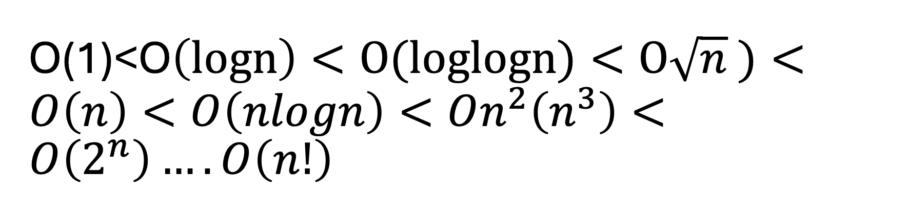
O(1)<O$\left(logn\right)<O(loglogn)<O\sqrt{n} )<O\left(n\right)<O\left(nlogn\right)<On^{2}\left(n^{3}\right)<O\left(2^{n}\right)….O\left(n!\right)$

